Slide 1
AJAX
Web 3 2015

Slide 2
Introduction
Since its inception, the Internet has used a transaction‐like communication model
A browser sends a request to a server, which sends a response back to the browser, which (re)loads the page.
This is typical HTTP communication, and it was designed to be this way.
But this model is rather cumbersome for developers, because it requires web applications to consist of several pages. The resulting user experience becomes disjointed and interrupted due to these separate page loads.
In the early 2000s, a movement began to look for and develop new techniques to enhance the user’s experience
The idea was to make web applications behave more like conventional applications.
These new techniques offered the performance and usability usually associated with conventional desktop applications.

Slide 3
AJAX
AJAX stands for Asynchronous JavaScript and XML
AJAX is a modern technique for creating better, faster, and more interactive web applications
Conventional web applications transmit information to and from the server using synchronous requests. It means you fill out a form, hit submit, and get directed to a new page with new information from the server
With AJAX, when you hit submit, JavaScript will make a request to the server, interpret the results, and update the current screen (the DOM really) BUT until the screen is updated the user can continue to use the application while the client program requests information from the server in the background.

Slide 4
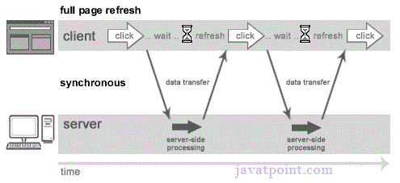
Synchronous (Classic Web-Application Model)

Slide 5
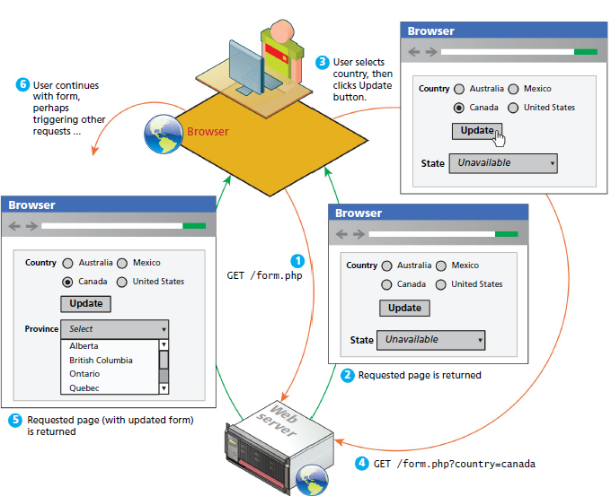
Normal synchronous non-AJAX page request-response loop

Slide 6
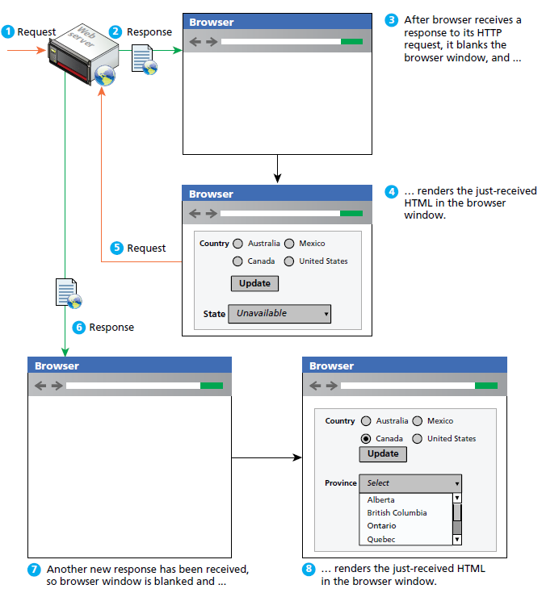
Normal HTTP request-response loop

Slide 7
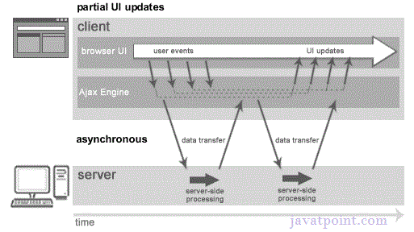
Asynchronous (AJAX Web-Application Model)

Slide 8
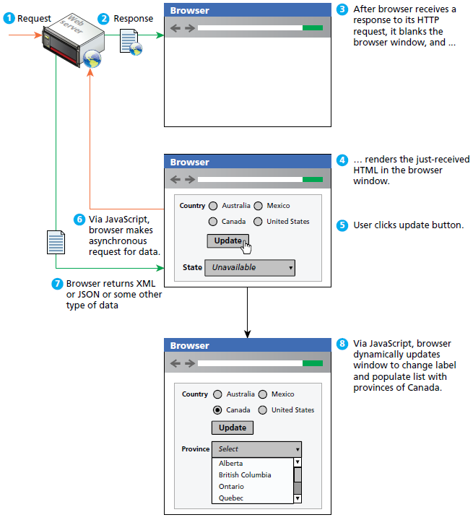
Asynchronous AJAX based data requests
-Ajax allows client‐side JavaScript to request and receive data from a server without refreshing the web page.
-This technique enables the developer to create an application that uninterrupted, making only portions of the page reload with new data.

Slide 9
Javascript and AJAX
AJAX is a web browser technology independent of web server software
AJAX responsiveness is created via asynchronous data requests using JavaScript XMLHttpRequest object
AJAX provides web authors with a way to avoid the visual and temporal deficiencies of normal HTTP interactions
With AJAX web pages, it is possible to update sections of a page by making special requests of the server in the background, creating the illusion of continuity

Slide 10
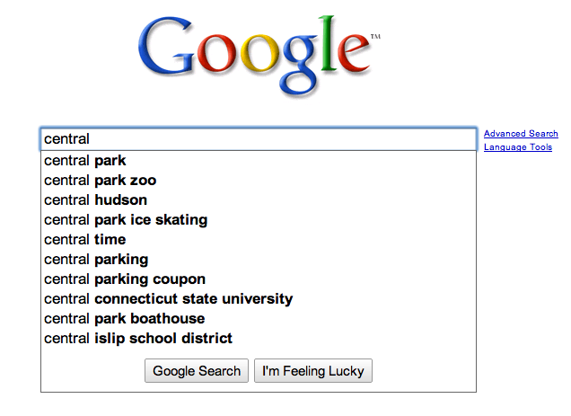
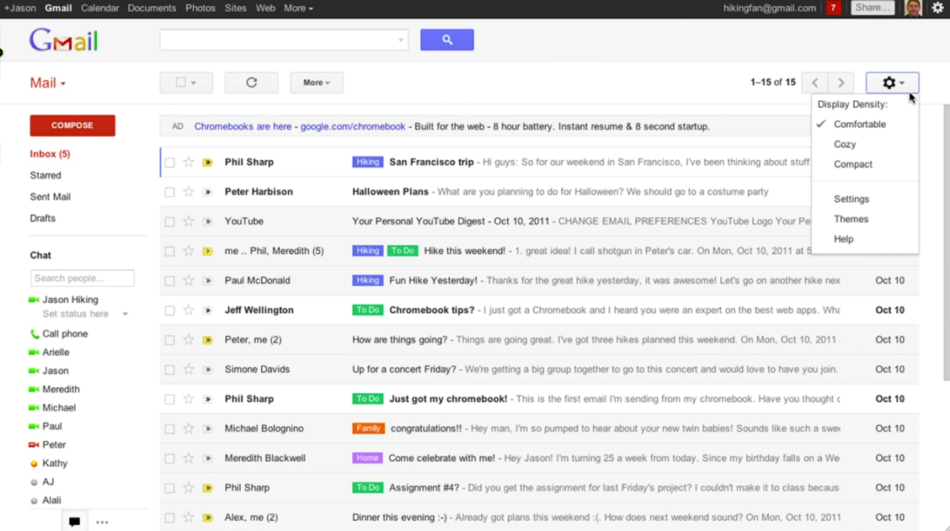
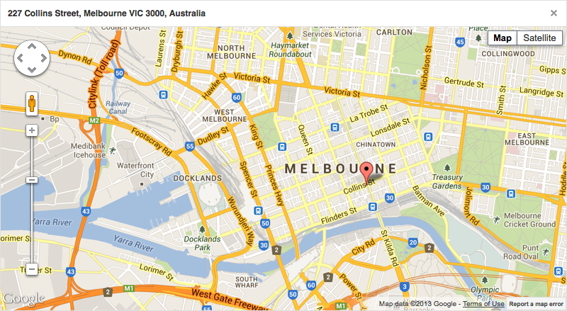
Notable AJAX Applications
Google Maps
Google Suggest
Gmail

Slide 11
Creating an XMLHhttpRequest Object
This line creates an XMLHttpRequest object, which you can use to connect to, and request and receive data from, a server.

Slide 12
Using the XMLHttpRequest Object
Once you create the XMLHttpRequest object, you are ready to start requesting data with it.
The first step in this process is to call the open() method to initialize the object
This method accepts three arguments.
requestType, is a string value consisting of the type of request to make. The value can be either GET or POST.
The second argument is the URL to send the request to
the third is an optional true or false value indicating whether the request should be made in asynchronous or synchronous mode.
Requests made in synchronous mode halt all JavaScript code from executing until a response is received from the server.

Slide 13
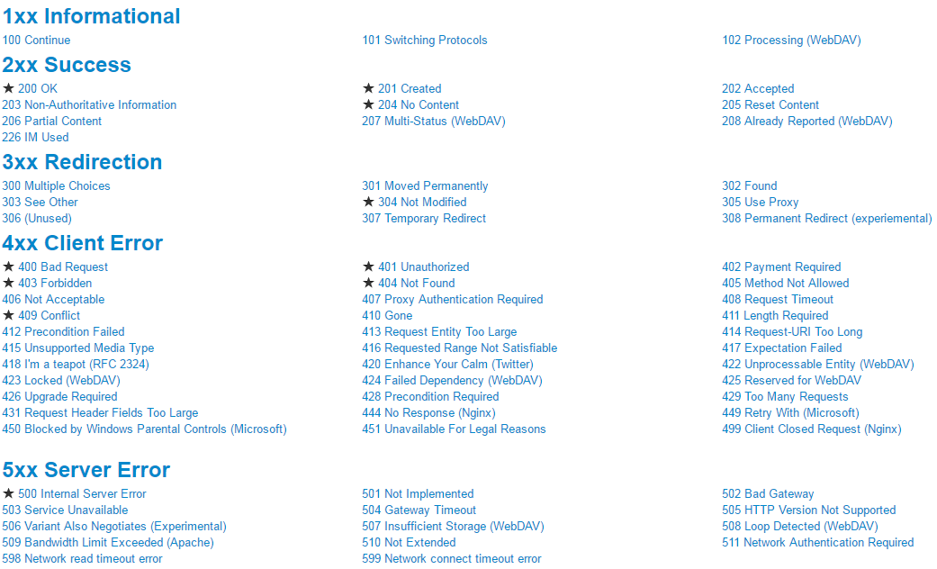
Status Property
Each XMLHttpRequest object has a status property.
This property contains the HTTP status code sent with the server’s response.
The server returns a status of 200 for a successful request, and one of 404 if it cannot find the requested file.

Slide 14
Asynchronous Requests
Asynchronous requests add some complexity to your code because you have to handle the readystatechange event.
In asynchronous requests, the XMLHttpRequest object exposes a readyState property, which holds a numeric value; each value refers to a specific state in a request’s life span
0: The object has been created, but the open() method hasn’t been called.
1: The open() method has been called, but the request hasn’t been sent.
2: The request has been sent; headers and status are received and available.
3: A response has been received from the server.
4: The requested data has been fully received.
The readystatechange event fires every time the readyState property changes, calling the onreadystatechange event handler.

Slide 15
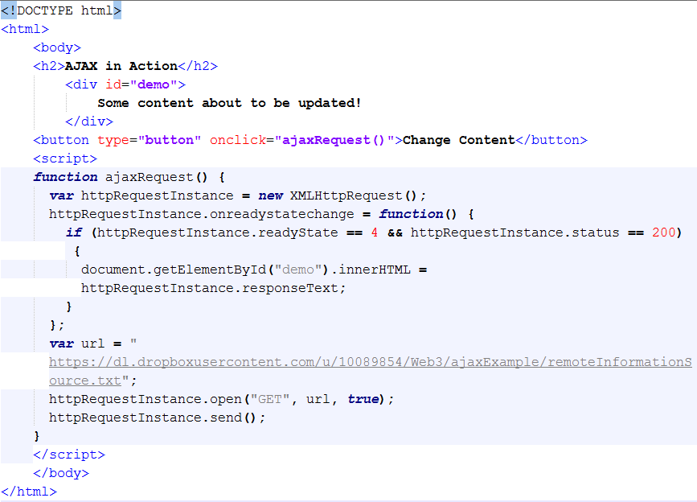
Ajax with XMLHttpRequest
http://liveweave.com/JLxkvf

Slide 16
Security issues with Ajax
JavaScript cannot access scripts or documents from a different origin.
This is a security measure that browser makers adhere to
The same‐origin policy dictates that two pages are of the same origin only if the protocol (HTTP), port (the default is 80), and host are the same
Consider the following two pages:
http://www.site.com/folder/mypage1.htm.
http://www.site.com/folder10/mypage2.htm.
According to the same‐origin policy, these two pages are of the same origin. They share the same host (www.site.com), use the same protocol (HTTP), and are accessed on the same port (none is specified; therefore, they both use 80).

Slide 17
The Same‐Origin Policy
Now consider the next two pages:
http://www.site.com/folder/mypage1.htm.
https://www.site.com/folder/mypage2.htm.
These two pages are not of the same origin.
The host is the same, but their protocols and ports are
different.
Page 1 uses HTTP (port 80)
Page 2 uses HTTPS (port 443).
This difference, though slight, is enough to give the two pages two separate origins.
Therefore, JavaScript on one of these pages cannot access the other page.

Slide 18
The Same‐Origin Policy
Because of this policy, an XMLHttpRequest object cannot retrieve any file or document from a different origin by default.
There is, however, a legitimate need for cross‐origin requests, and the W3C responded with the Cross‐Origin Resource Sharing (CORS) specification.
The CORS specification defines how browsers and servers communicate with one another when sending requests across origins.
For CORS to work, the browser must send a custom HTTP header called Origin that contains the protocol, domain name, and port of the page making the request.
When the server responds to a CORS request, it must also send a custom header called Access‐Control‐Allow‐Origin, and it must contain the same origin specified in the request’s Origin header.
If this header is missing, or if the origins don’t match, the browser doesn’t process the request.
Alternatively, the server can include the Access‐Control‐Allow‐Origin header with a value of *, signifying that all origins are accepted.

